Slide 1
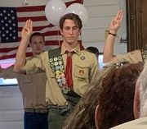
Education & Outreach Committee Our Work for 2022
Identifying Big Ideas in Home gardening and selecting a theme for the year.
A number – not all - of workshops, FB posts, articles will connect to the theme.
3. Past theme – Gardening for the Health of It.

Slide 2
Develop a year-long series of educational opportunities for the public as well as PD for ourselves to enrich understanding with particular attention to our theme. i.e. lunch & learns; book/article website shares; What’s Up OMGs?

Slide 3
Develop an OMG Speaker's List
What are some topics you know well?
Work alone or with others.
Respond to requests for speakers or presentations
Let your community know you’re willing to help

Slide 4
Public Relations for our Work
Articles
Press Releases
Posters
Graphics
Photography

Slide 5
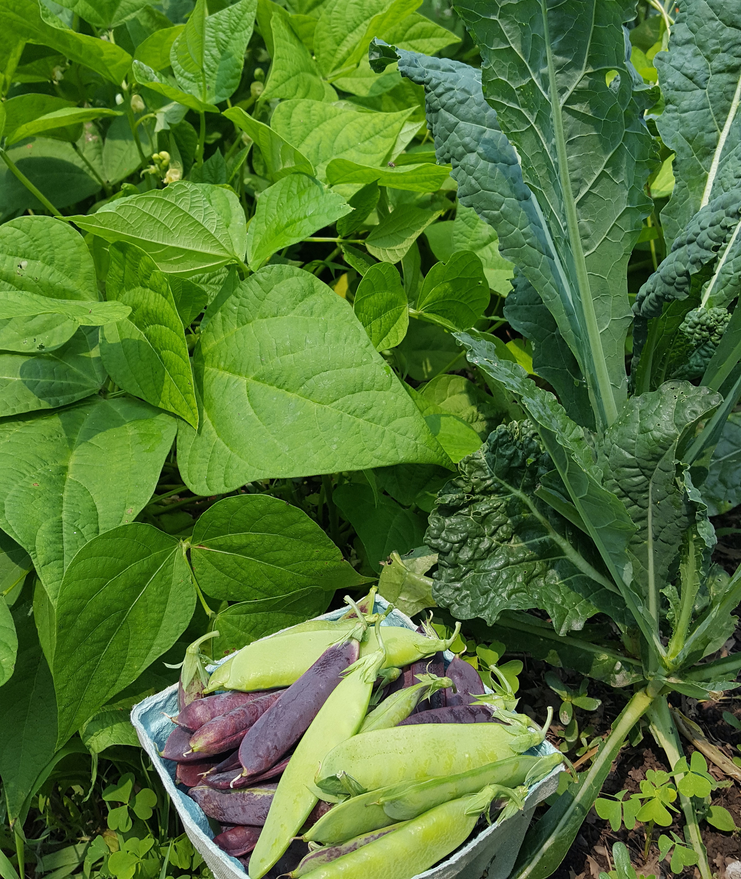
Work on Ways to Extend our Outreach Through Workshops and GROW
Horticulture is local
How could we help the community
Helping doesn’t have to be a major PROJECT

